Slide 1
PROJECT GLADIATOR
RETAIL DOMAIN

Slide 2
Problem Statement
The E-commerce industry is growing like never before. In its process of growth, it is
rapidly creating tons of data. Without processing this data, it becomes challenging to
obtain insights from it. As Data engineers at RMR Mart, our objective is to prepare,
cleanse, validate, enrich, transform and store the Retail data.
Big data in Retail include:
● Maintaining a 360-degree view of RMR Mart sales
● Optimize product pricing & discounts
● Enhance customer service

Slide 3
Technical specifications
Data sources: Flat files , RDB ,logs (streams) , S3 , Redshift, snowflake, DynamoDb
Data Storage : HDFS , Hive , S3 ,Redshift, Snowflake ,Dynamo
File formats : Parquet, ORC, JSON, CSV
Compression Codecs: Bzip2,Gzip,Snappy
Data Ingestion : Sqoop , Spark
Data cleansing and scrubbing : Hive , Spark , SQL /Python
Data computation and Analysis : PySpark ,SQL (SparkSQL/snowflake/Redshift)
ETL : Hive /Spark/Snowflake
Visualization : Qlik Sense
Language : Python

Slide 4
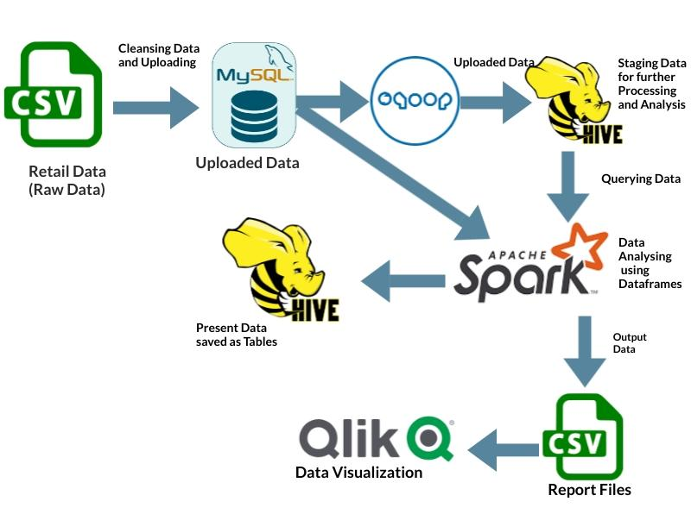
Workflow Diagram

Slide 5
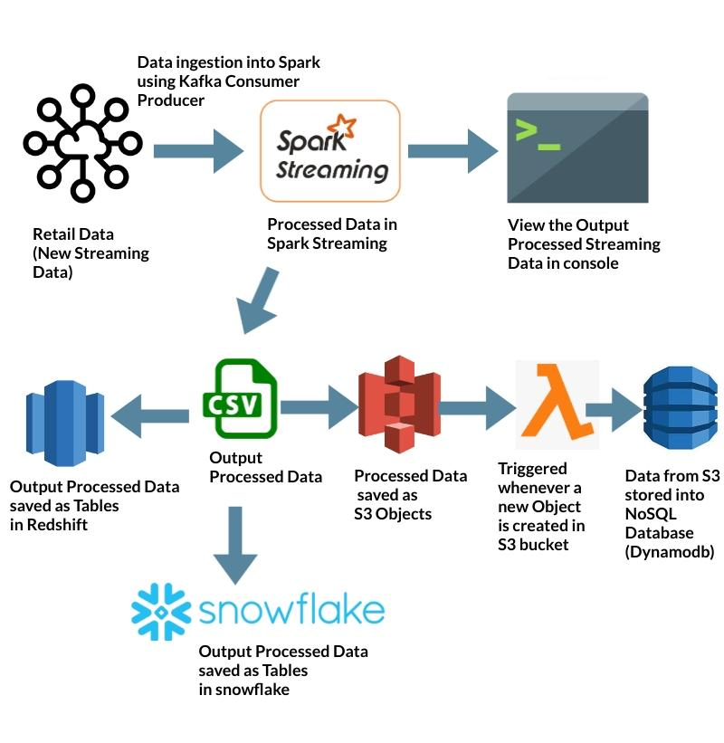
Workflow 2

Slide 6
Visualizations of the queries

Slide 7
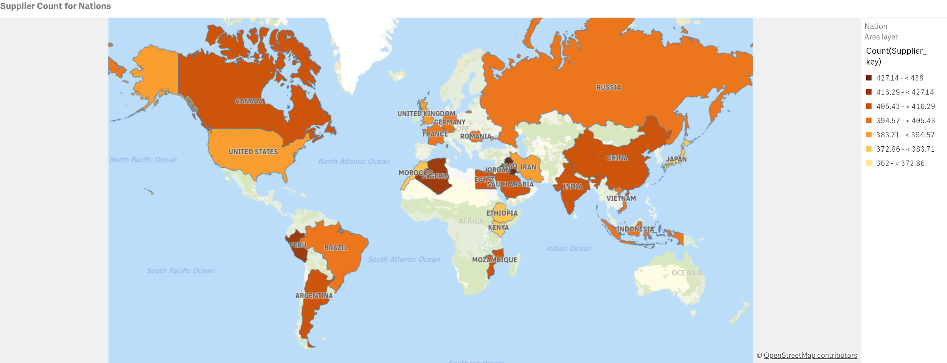
Display the number of suppliers per nation.

Slide 8
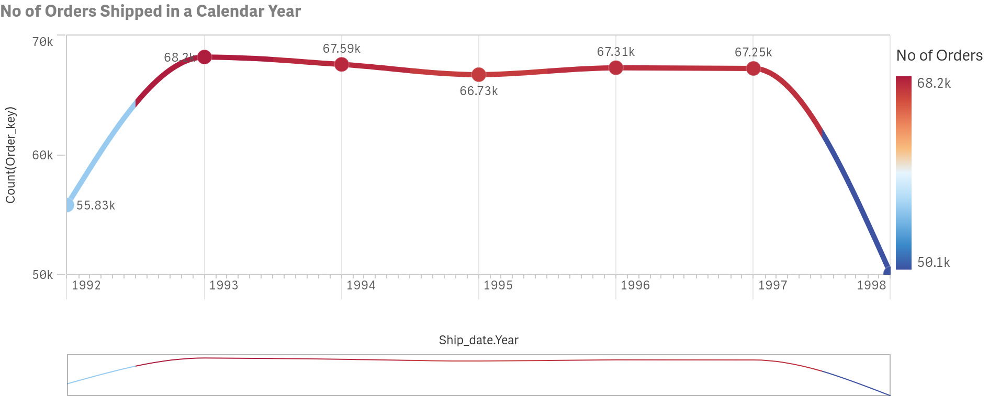
The Retail Company Wants to know the number of orders shipped in a calendar year.

Slide 9
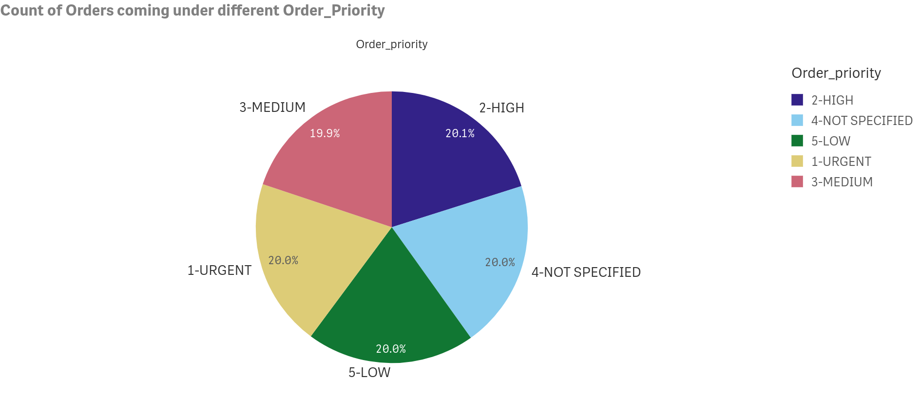
The Retail Company Wants to know the number of orders shipped in a calendar year.

Slide 10
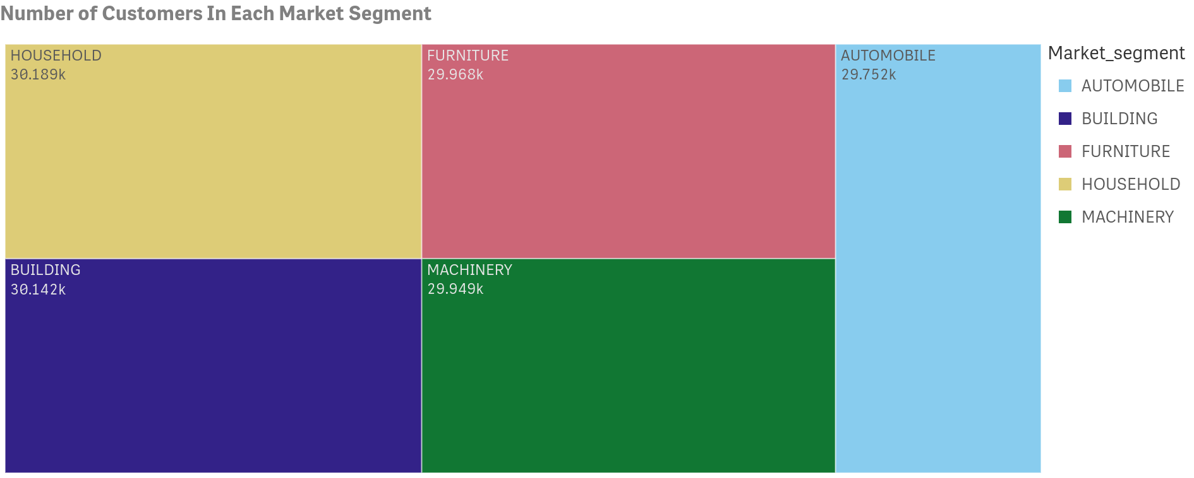
Retail Company wants to know the Number of customers present in Each Market Segment.

Slide 11
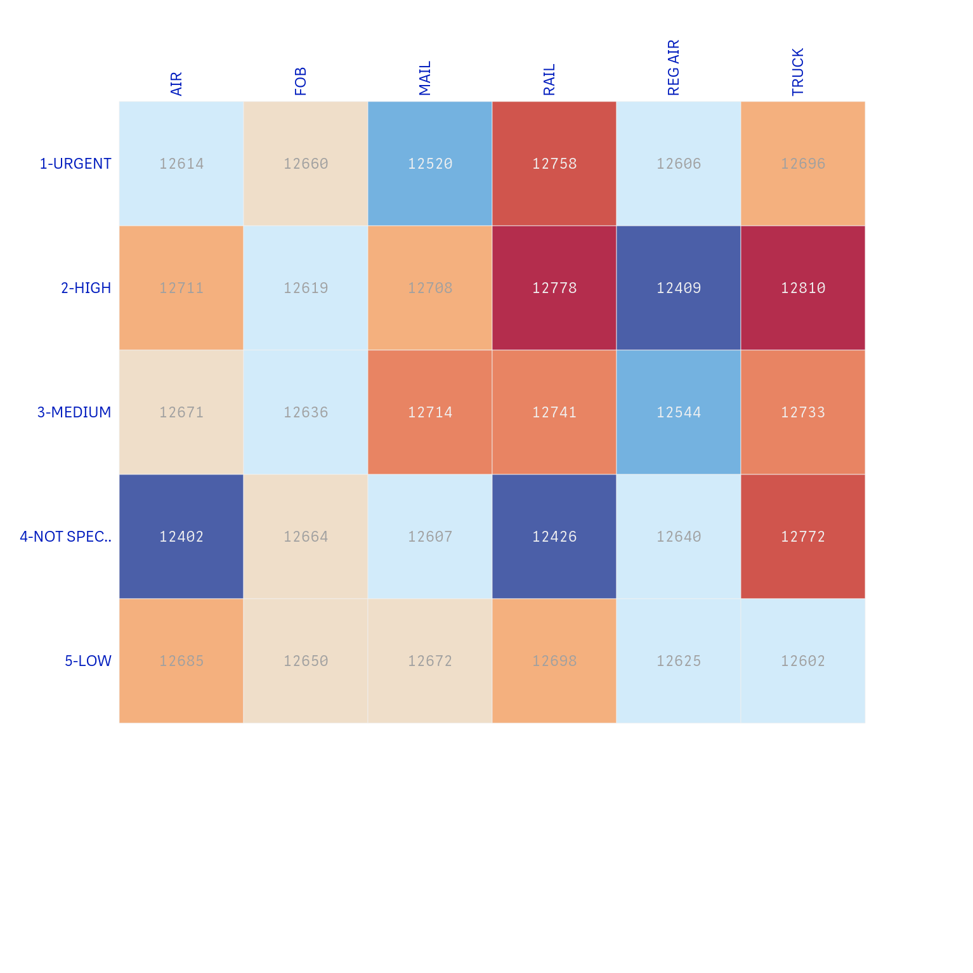
The Retail Company wants to know the most frequent shipment modes for every order priority

Slide 12
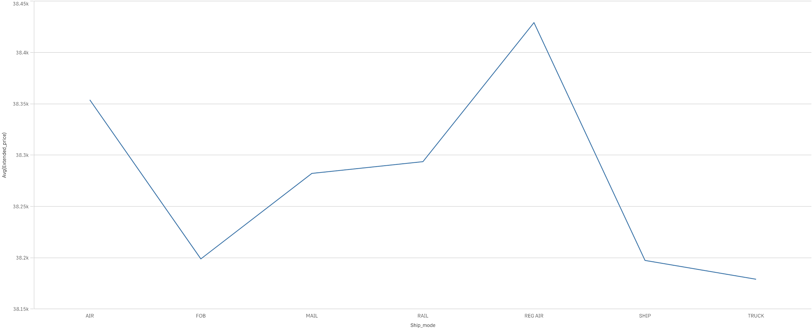
The Shipping department at the retail company wants to know the breakdown of services of the different modes of shipment. Help him analyze the required data.

Slide 13
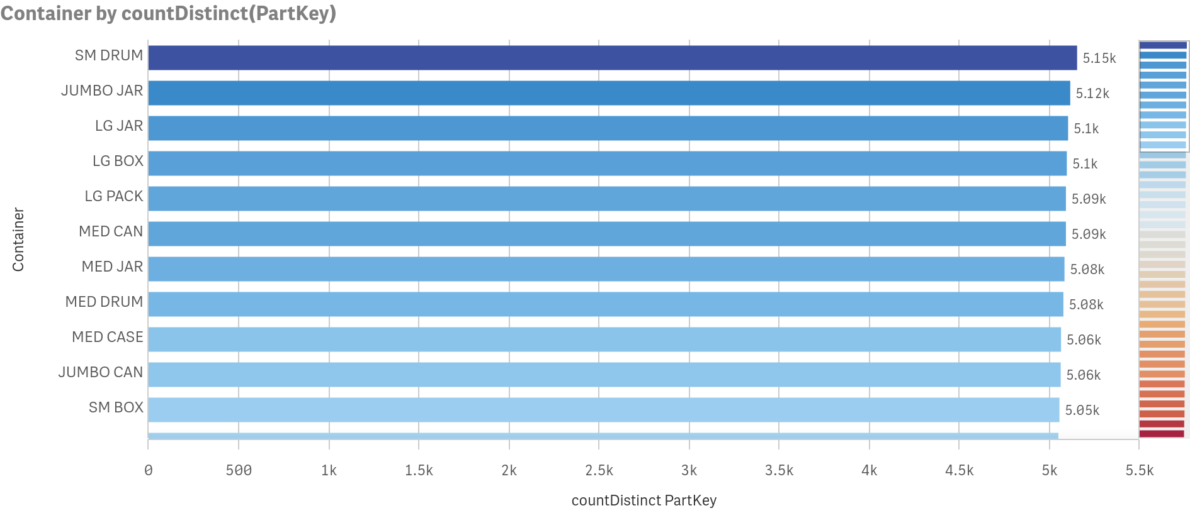
The Shipping Company wants to know the most used Container for shipping the parts.

Slide 14
Challenges
The data available was not fully clean so while importing various cleansing methods had to be applied
It was difficult to run complex queries due to the limitations of the virtual machine. So we had to find a way around it
It was difficult to find the appropriate packages to import while starting pyspark for S3 and spark integration
Type casting had to be done wherever necessary. Specially during the Kafka load when the values were normally being displayed in binary format

Slide 15
THANK YOU

